Slide 1
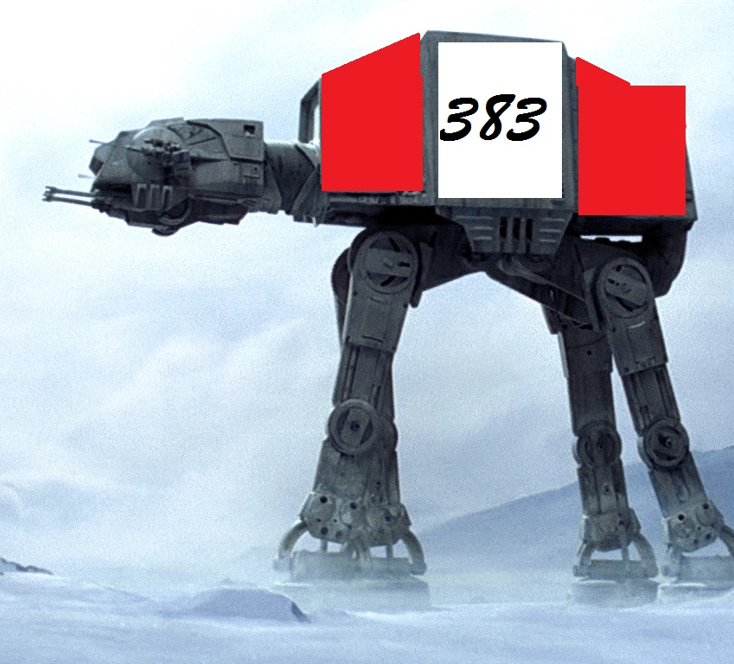
Sound Sentinel by 383

Slide 2
Sound Sentinel
Things to put here….
Name
Goal
Story

Slide 3
383 Studios
Amanda
Tristan
Austin
Tyrel

Slide 4
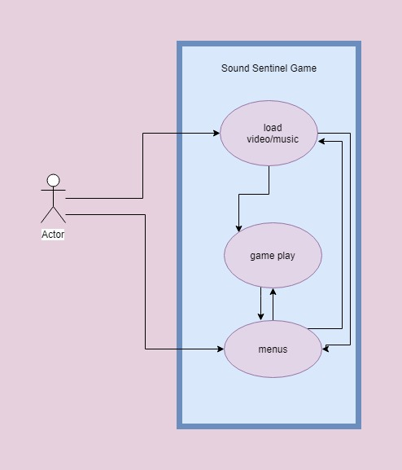
Global Use Case

Slide 5
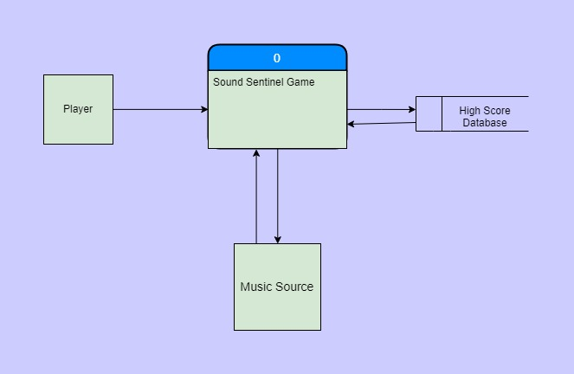
Context Diagram

Slide 6
Diagram 0

Slide 7
Amanda

Slide 8
Tyrel

Slide 9
Austin

Slide 10
Tristan

Slide 11

Questions?

